Slide 1

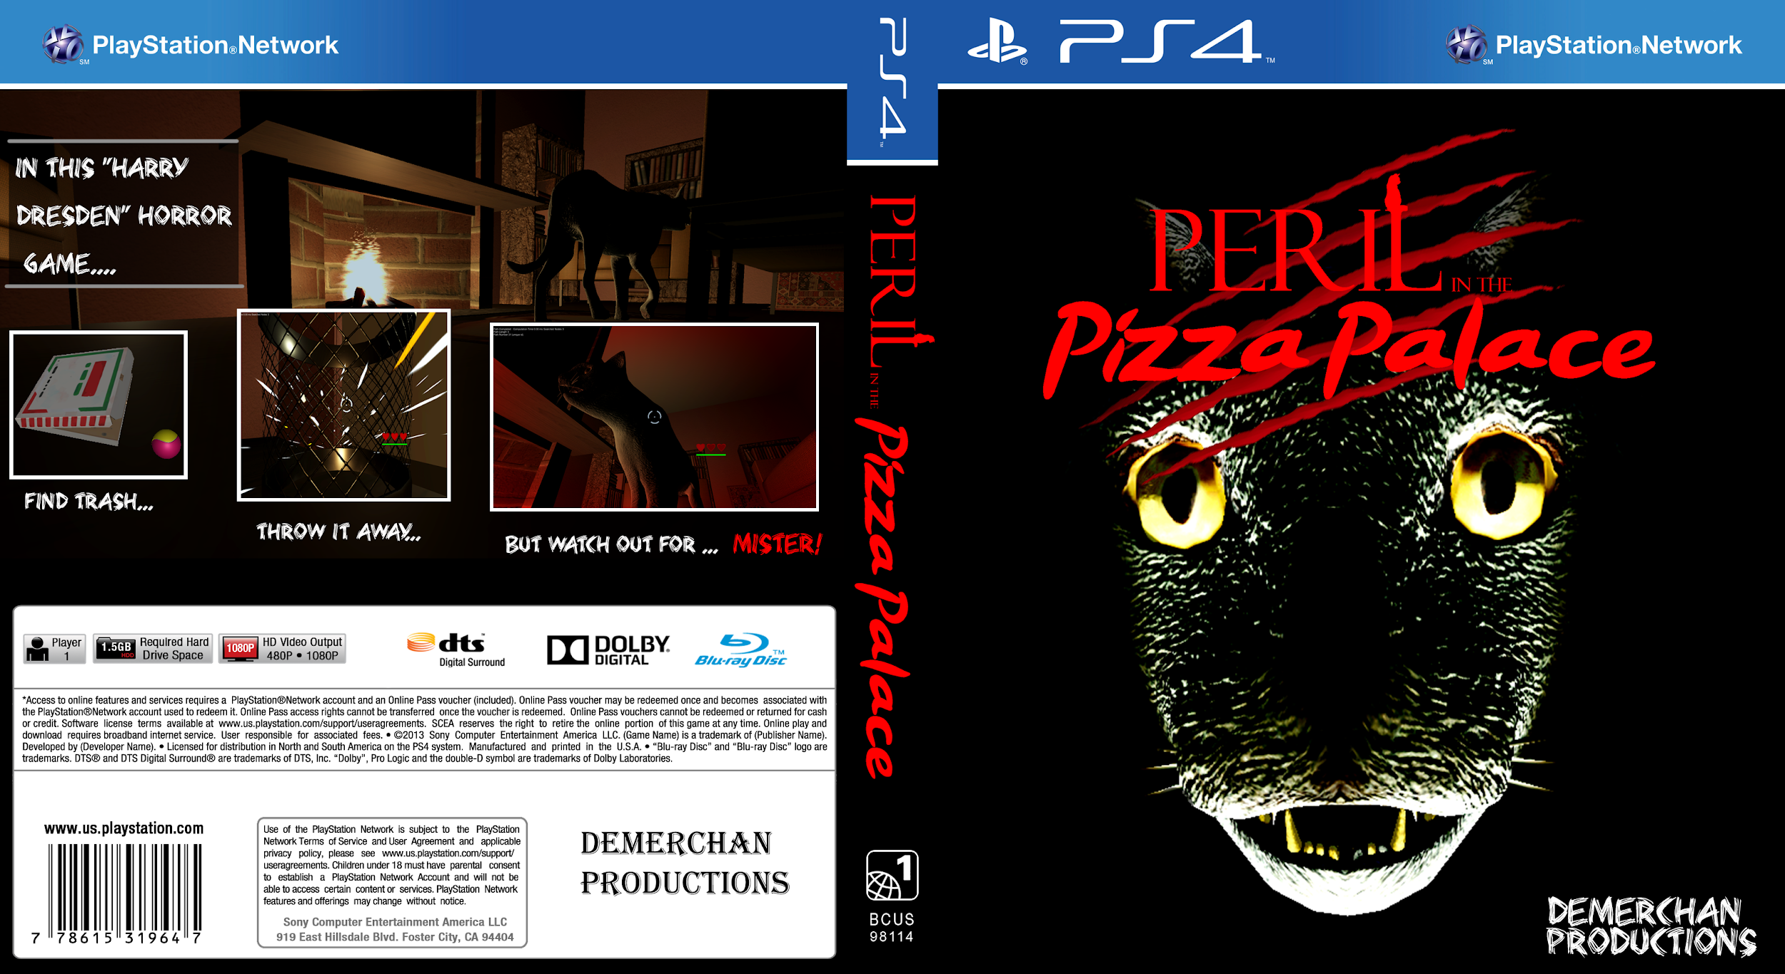
Demerchan
Ryan Beach, Berkley Knowles, Kyler McQuillan,
Nick Rasmussen, Alex Sarnese
Notes:
Do remember to introduce your team members by name individually.

Slide 2
The Team
Kyler - Team Lead. Project Architecture, Sound, and Player/Trash Mechanics.
Alex - UI/UX and AI Lead.
Nick - Backend Lead.
Berkley - Art Lead.
Ryan - Lead Designer. Level layout designs.
Notes:
Everyone describe what they did

Slide 3
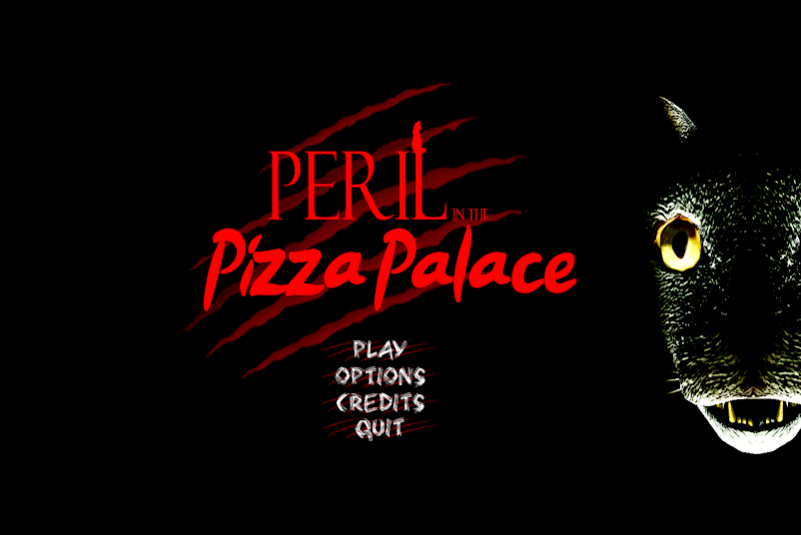
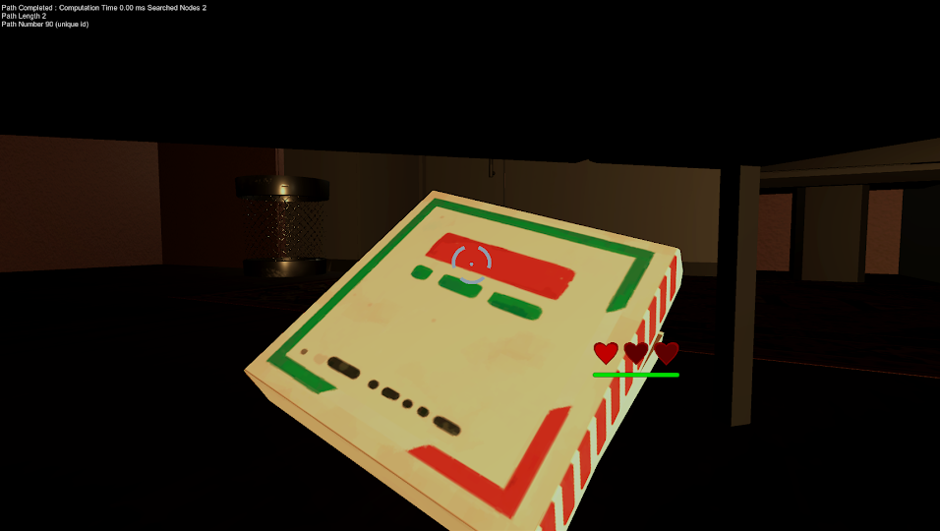
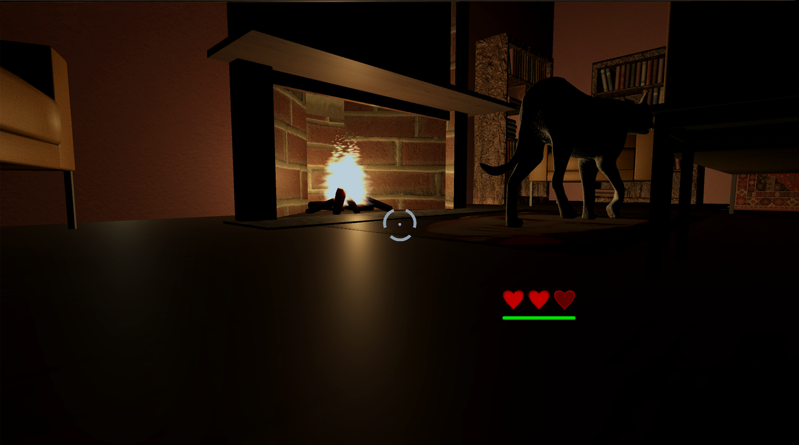
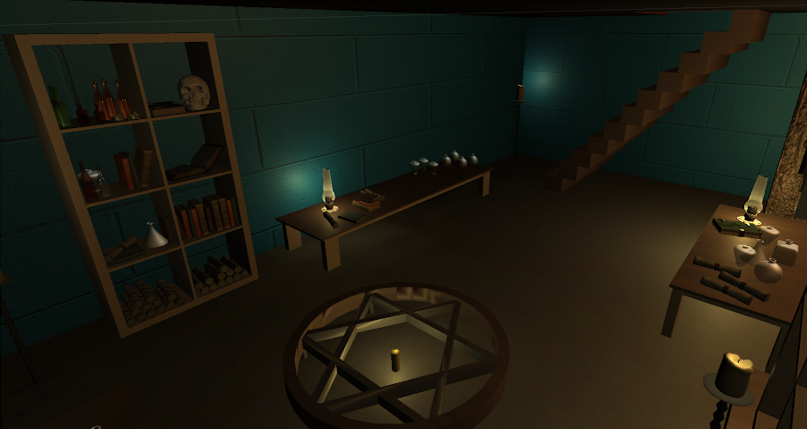
Peril in the Pizza Palace
Notes:
What is the game about? Do you have a tagline?
How should the player feel?
What is the objective?
What is the end condition?
What is the win condition?
How many players?
Target audience?

Slide 4
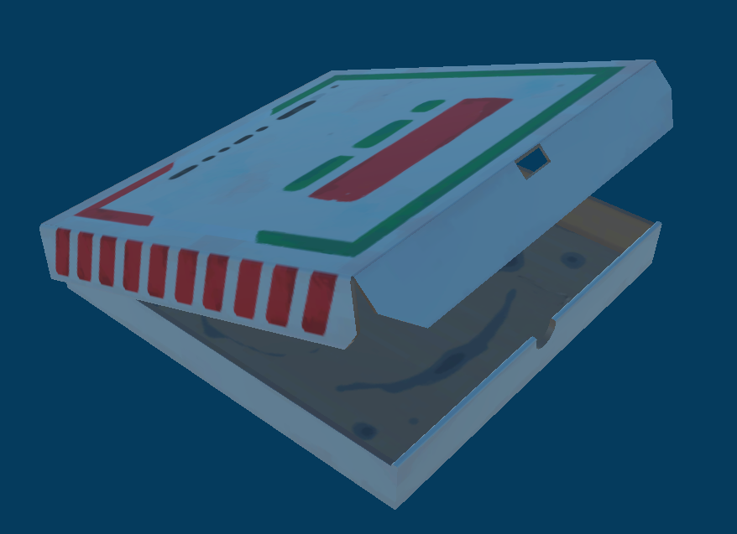
Summary
Theme:
Dresden files, 1 player, trash-pickup simulator/horror game
3D horror feel for art
Intro Statement:
“Look for trash in the apartment. When you find some, pick it up and drop it into the trash can! But watch out for the cat. You better be ready to run or hide....”
Interactive items:
Trash items have a pulse effect on their shader so they are easier to spot. If the crosshair is on the trash and the player is in range, the player can hold left click to hold the trash in front of them.
Notes:
Alex S
Clearly describe your game so I know how the game is played

Slide 5
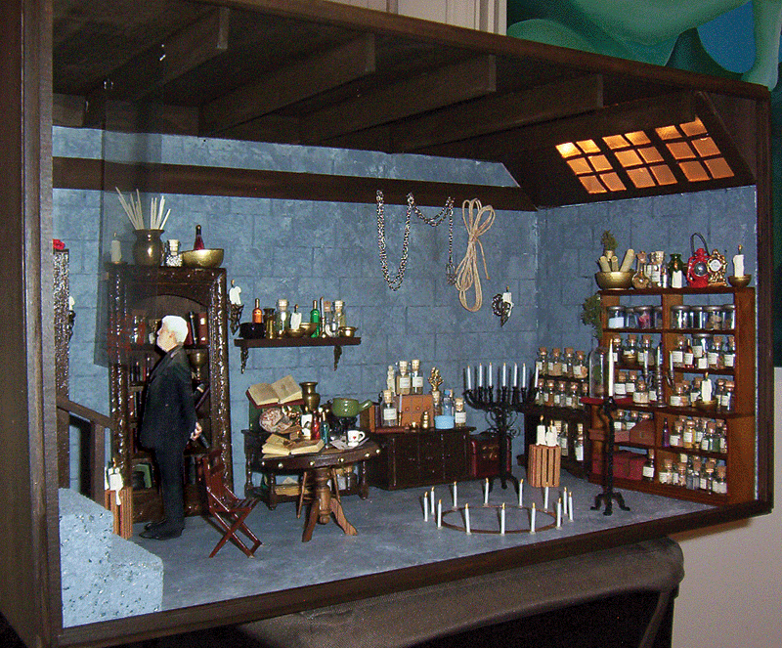
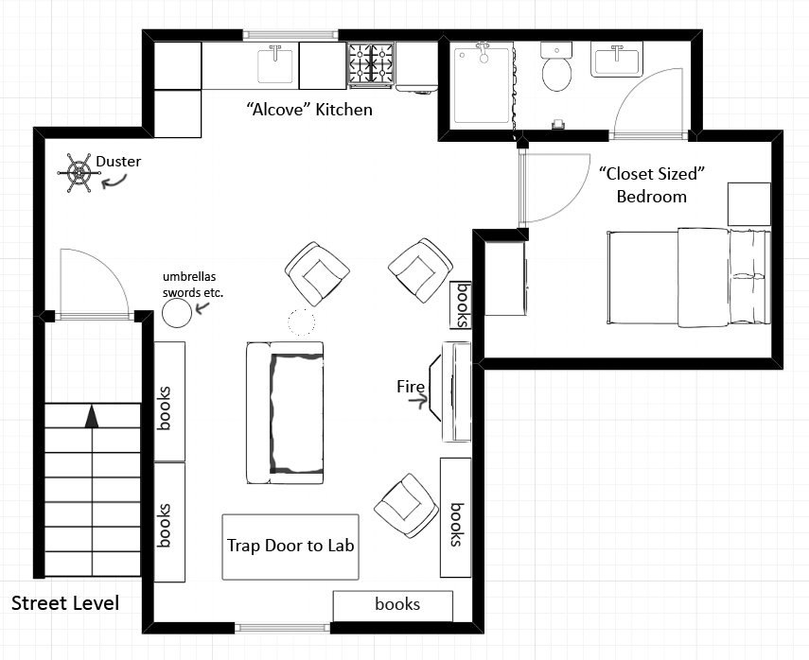
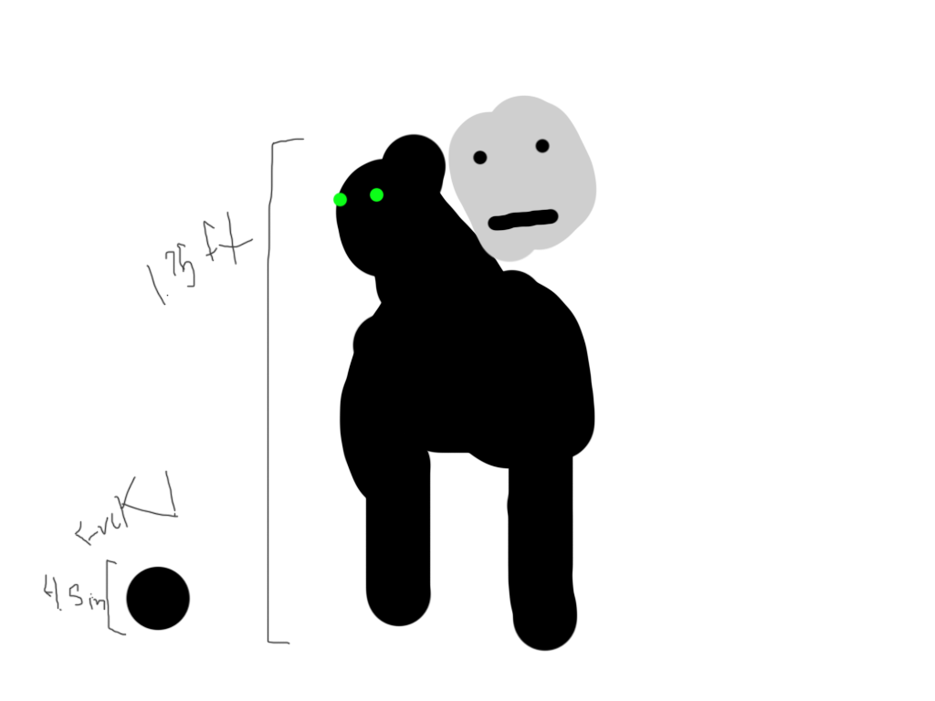
Original Concepts
Notes:
Alex S

Slide 6
Gameplay
Brave the lair of the Dread Beast for a sweet, saucy slice!
Target Audience:
Our game is for all ages 10+, mainly those interested in fantasy
It is a one player, 3D trash-pickup and goofy horror game
Win condition:
Throw away all of the trash in the level by putting them in the trash cans (5 items)
Win screen allows player to go back to title

Slide 7
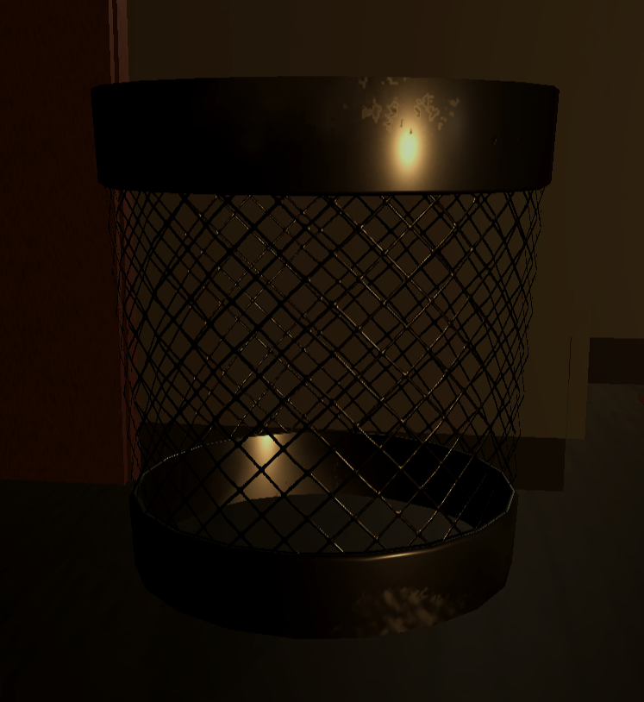
Gameplay Part 2
Brave the lair of the Dread Beast for a sweet, saucy slice!
Core mechanics:
Picking up and holding trash
Trash despawning when thrown away
Cat pathfinding
Cat tracking and attacking player
Lose Condition:
If the player gets hit by the cat 4 times, they die
On the loss screen, the player may return to the title screen

Slide 8
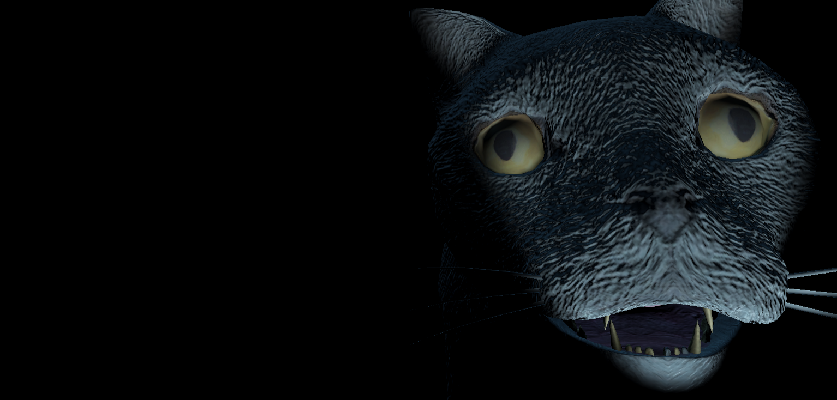
What are the strengths and weaknesses of the game
Strengths:
Surprisingly scary
Aesthetic
Fun for a quick game to play
Weaknesses:
Only a single level currently
Not much variety in gameplay
Cat pathfinding can encounter bugs
Notes:
This is reflection of the game at its current state. The expectation is not a complete fully polished game: this is a proof of concept prototype.

Slide 9
Strengths and Weaknesses of the team
Strengths:
Strong communication and meeting deadlines
Most deadlines were met
Very good organization
Cleanliness (lots of trash thrown away)
Weaknesses:
Did not find time to tackle most stretch goals
Haven’t made time for blind playtests outside of class
Team meetings fell off as fall break came around

Slide 10
Lessons learned
Is this game worth further development?
Yes, there a lot of ways in which this game can continue development.
There are some small bugs that could use fixing as well as some AI fixes.
What will you do going forward?
Continue using Discord for communication and coordination
Improve and polish the current mechanics
What advice would you give yourselves or others?
Make sure you start with the core of the game before attempting other parts of it.
Before using a library or feature from online, test it first to make sure it works and can be integrated easily into your current system/code.

Slide 11
Future Work
Add Bob into the game
Add fun magic stuff and other interactable items
Better performance AI for Mister the cat
Perhaps multiplayer?
More trash assets
Notes:
In terms of future work, do include what the game would look like with all the money in the world. It could be here, or in the game walk-through portion. Ultimately I want to know how the game would look, feel and play. Of course, you could say that we discovered that the prototype is not worth further development because...

